Slide 1
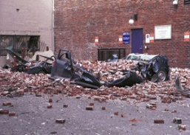
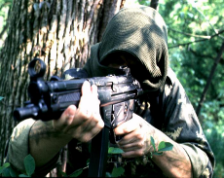
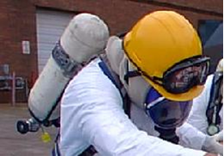
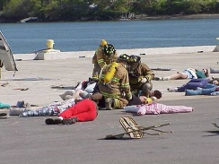
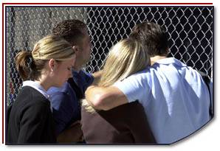
Disaster Site Worker Safety
Traumatic Stress

Slide 2
Objectives
Define traumatic stress.
List the symptoms of acute traumatic stress.
Describe the key components of traumatic stress management.
Understand features of post-traumatic stress disorder.

Slide 3
Introduction
Inability to cope with stress can lead to deficits in:
Physical well-being.
Cognitive abilities.
Emotional stability.
Behavioral.
Traumatic Incident Stress Information for Emergency Response Workers – NIOSH Publication 2002-107.

Slide 4
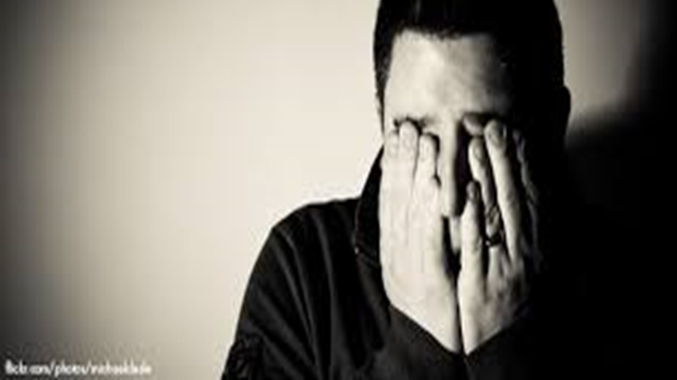
Introduction
Anyone involved in traumatic events has the potential to experience:
Physical illness.
Inability to function adequately on the job.
Depression.
Anxiety.
Marital and family conflict.
Death through suicide as a reaction to overwhelming stress.

Slide 5
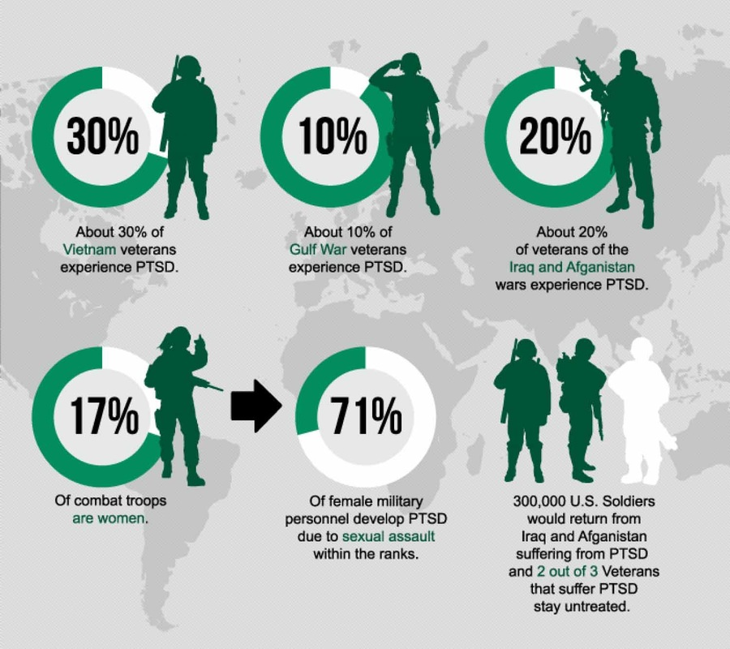
Concepts and Principles

Slide 6
Traumatic Event
An incident in which an individual experienced, witnessed or learned about actual or threatened death or serious injury, or a threat to the physical integrity of self or others and the individual’s response involved intense fear, helplessness, or horror

Slide 7
Traumatic Event
Most frequently experienced traumas are:
Witnessing someone being badly injured or killed.
Being involved in a fire, flood, or natural disaster.
Being involved in a life-threatening accident.
Combat exposure.

Slide 9
Acute Traumatic Stress
Stress - A state of physical and psychological arousal that follows any demand made upon an individual
Traumatic Stress - A distinctive pattern of physical, mental, and emotional responses is seen in the majority of individuals after experiencing a traumatic event
Increased arousal and anxiety
Sleep difficulties
Emotional numbness and withdrawal
Preoccupation with and re-experiencing of the traumatic event

Slide 10
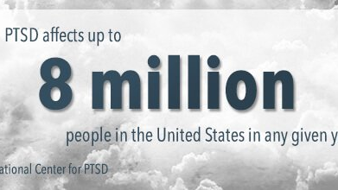
Post-Traumatic Stress Disorder (PTSD)
Individual experiences significant emotional distress or experiences difficulties functioning on the job, socially, in personal relationships, or other important areas of his life.

Slide 11
Post-Traumatic Stress Disorder (PTSD)
PTSD is a disorder that develops in some people who have experienced a shocking, scary, or dangerous event.
It is natural to feel afraid during and after a traumatic situation. Fear triggers many split-second changes in the body to help defend against danger or to avoid it. This “fight-or-flight” response is a typical reaction meant to protect a person from harm. Nearly everyone will experience a range of reactions after trauma, yet most people recover from initial symptoms naturally. Those who continue to experience problems may be diagnosed with PTSD. People who have PTSD may feel stressed or frightened even when they are not in danger.
National Institute of Mental Health (NIH)

Slide 12
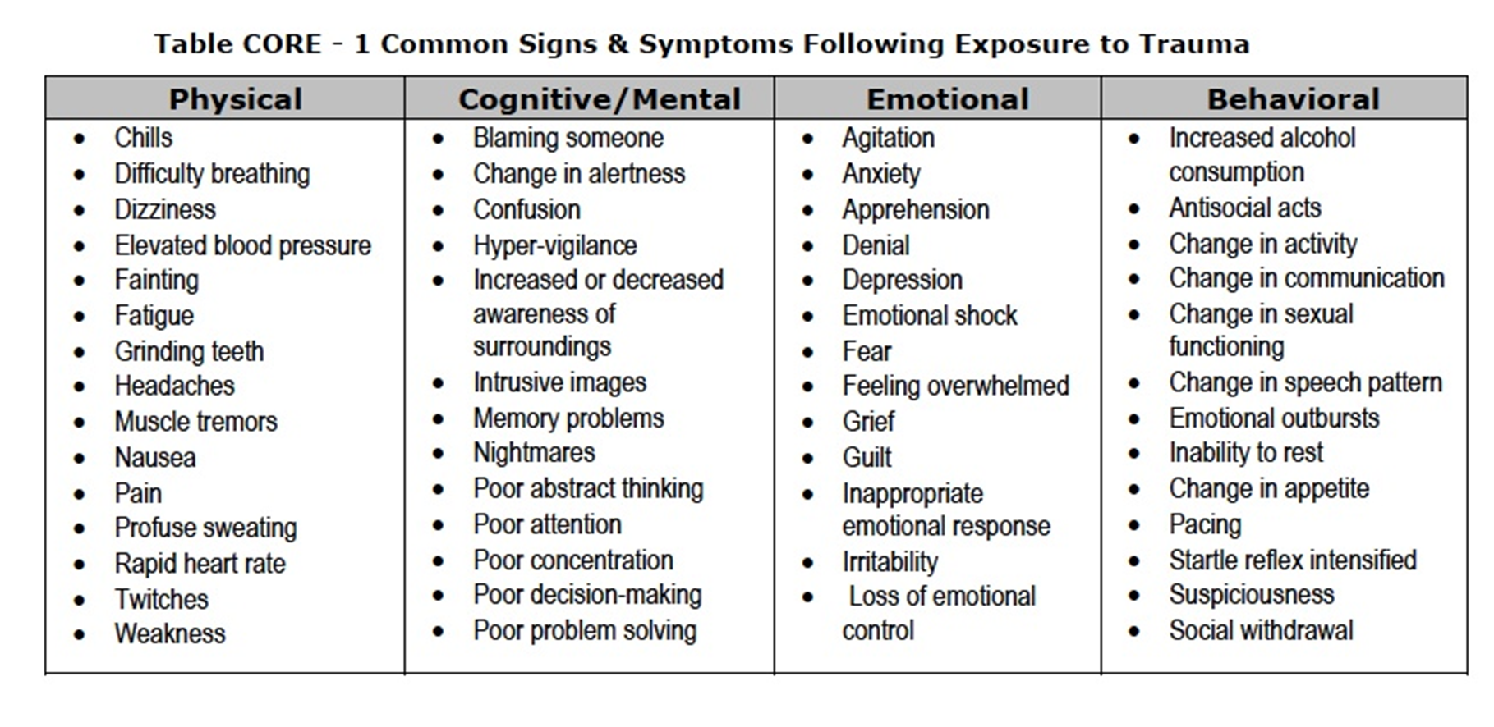
Post-Traumatic Stress Disorder (PTSD)

Slide 13
Post-Traumatic Stress Disorder (PTSD)
To be diagnosed with PTSD, an adult must have all of the following for at least 1 month:
At least one re-experiencing symptom
At least one avoidance symptom
At least two arousal and reactivity symptoms
At least two cognition and mood symptoms

Slide 14
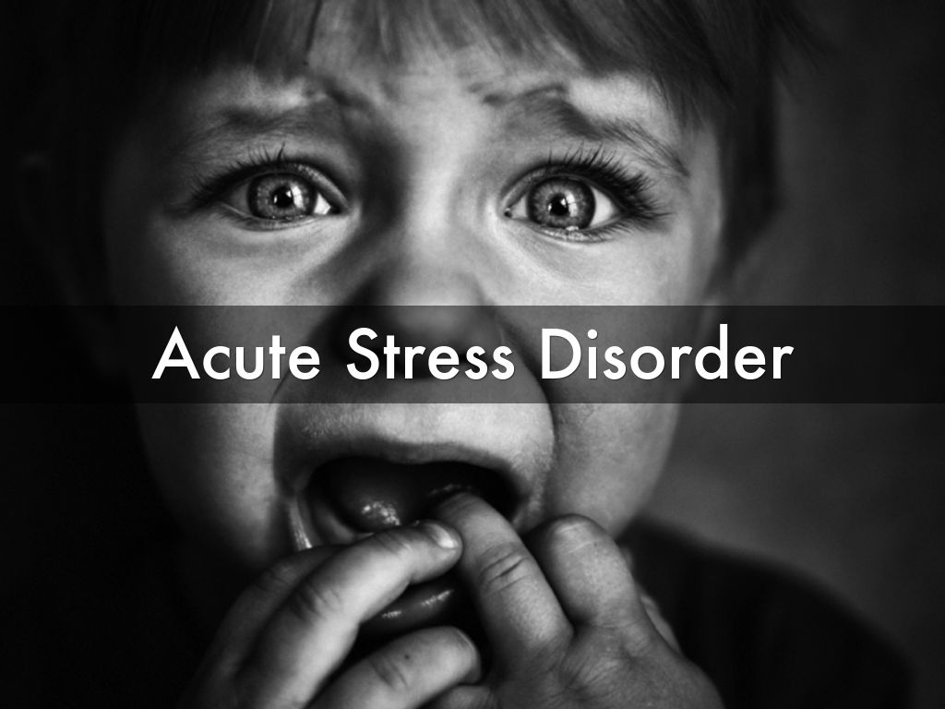
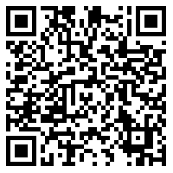
Acute Stress Disorder
Also known as psychological shock, acute stress disorder or mental shock, the acute stress reaction refers to a condition that arises as a response to a traumatic event.
ASD or acute stress disorder is always a result of a traumatic event and that’s by the very definition of the disorder. It happens when a person witnesses or experiences an event that causes him a disturbing level of fear or stress. Usually it also involves a serious injury or the threat of a serious injury.
http://www.historic-columbus.org/acute-stress-disorder-psychological-shock-details/
Notes:
It consists of 2 out of 3 PTSD symptoms.
Persistent arousal
Persistent avoidance
Persistent re-experiencing

Slide 15
Risk Factors for PTSD
PTSD may lead to:
A personal history of physical or sexual abuse
A personal history of depression or other emotional disorder
Lack of a positive social support system
Alcohol or other drug abuse
A family/social environment that produces feelings of guilt and shame

Slide 16
Resilience to Traumatic Stress
A capacity to stay calm
A belief in self and one’s own strengths
Ability to remain task-oriented
Ability to accept fear in self and others but prepared for danger
Avoidance of isolation
Ability to find meaning

Slide 17
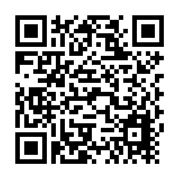
Critical Incident Stress Management (CISM)
Core components of CISM
Pre-crisis preparation or education
Community support programs for disasters
Defusing
Critical incident stress debriefing (CISD)
One-on-one crisis intervention/counseling
Family crisis intervention
Follow-up/referral mechanisms
OSHA – Critical Incident Stress Management

Slide 18
Community Support Programs
Incorporated into disaster plans of:
Businesses
Schools
Communities
Such support programs may include:
Demobilizations of staff
Providing a transition period
Consultation for public safety and disaster personnel
Crisis management briefings and “town meetings” for civilian populations

Slide 19
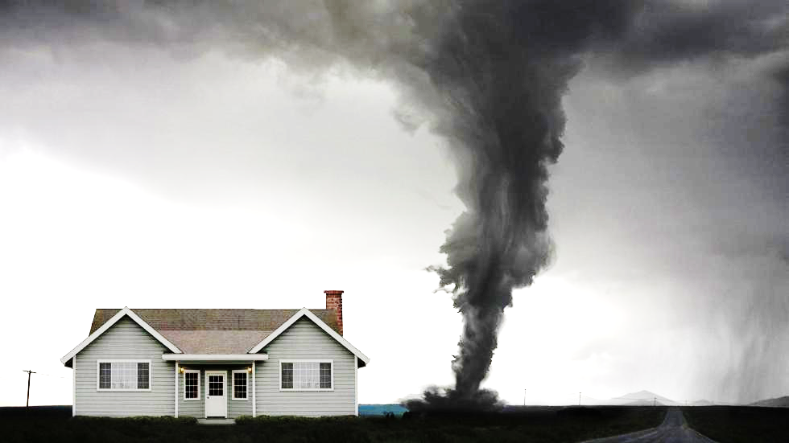
Dashboard
CBRNE

